Slide 1
WattTrack
Group Name: The Cool Kidz
Members: Ang Kok Hwee, Lee Weichen

Slide 2
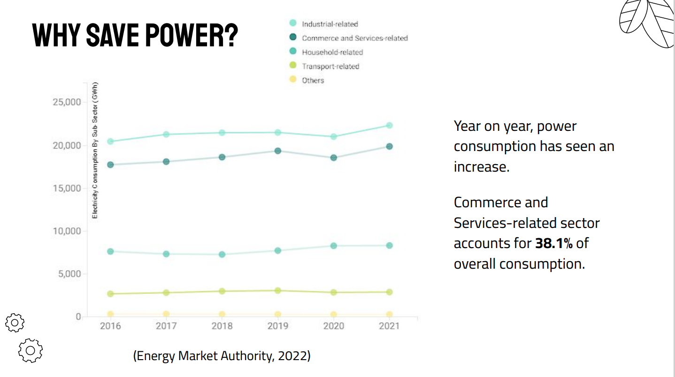

Slide 3
Problem
Current IoT solutions have built in power saving functions, but most require heavy teardown of current system, or installation into the mains.
General consumers lack awareness on power consumption.

Slide 4
Optimizing Electricity COnsumption Through Machine Learning
01
The electric bill is a concern for the middle class people.
Unnecessary usage of Appliances - Summers are unbearable without ACs but unnecessary usage will lead to high bill amount
02
Faulty/Old appliances – Certain appliances which are faulty or have become really old consume high amount of electricity
03

Slide 5
Solutions
Anomaly detection for Faulty Devices
04
Smart control of appliances
Generate anomalies in the daily consumption data when there is extra consumption by an appliance because of some shortage in the supply line
Learning from daily usage and controlling usage of appliances based on time, weather, etc.
01
03
Detecting appliances that consumes maximum electricity
Forecasting Usage of electricity
Find out heavy appliance that consumes maximum electricity
Using data science to forecast electricity consumption every month
02

Slide 6
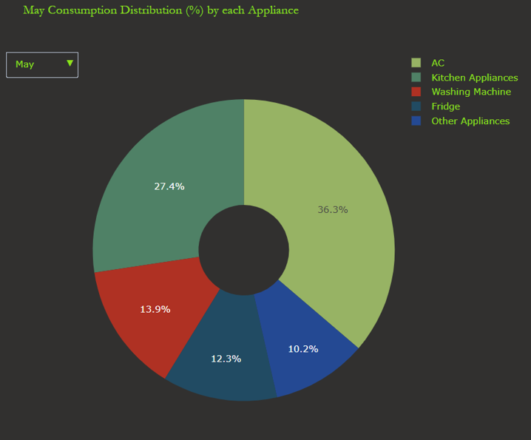
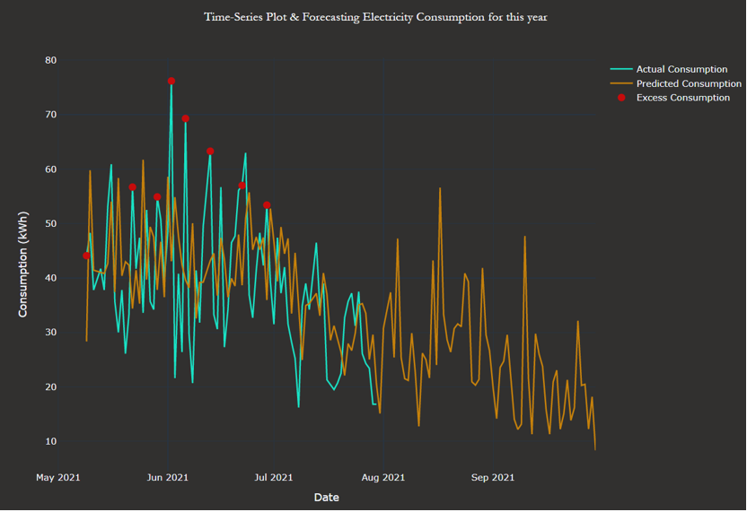
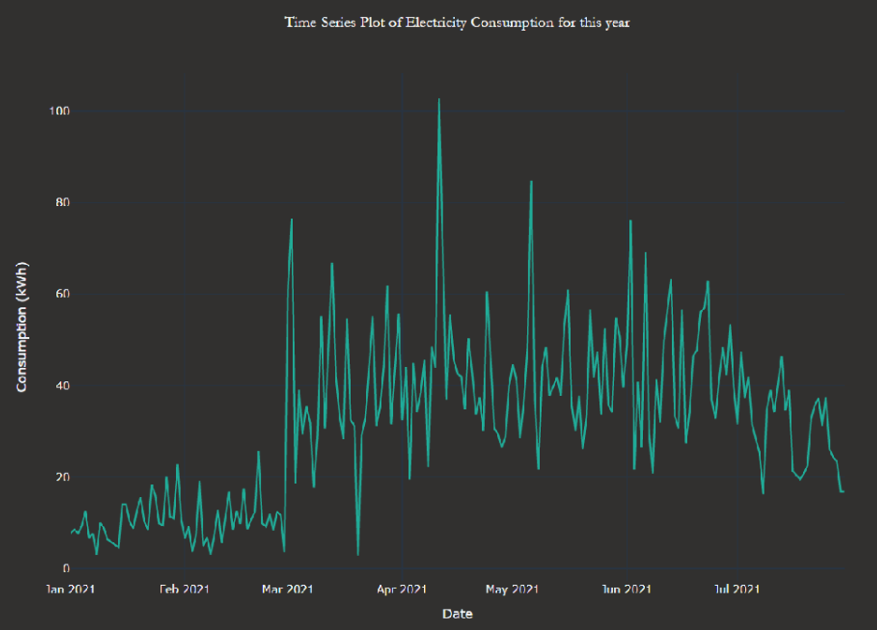
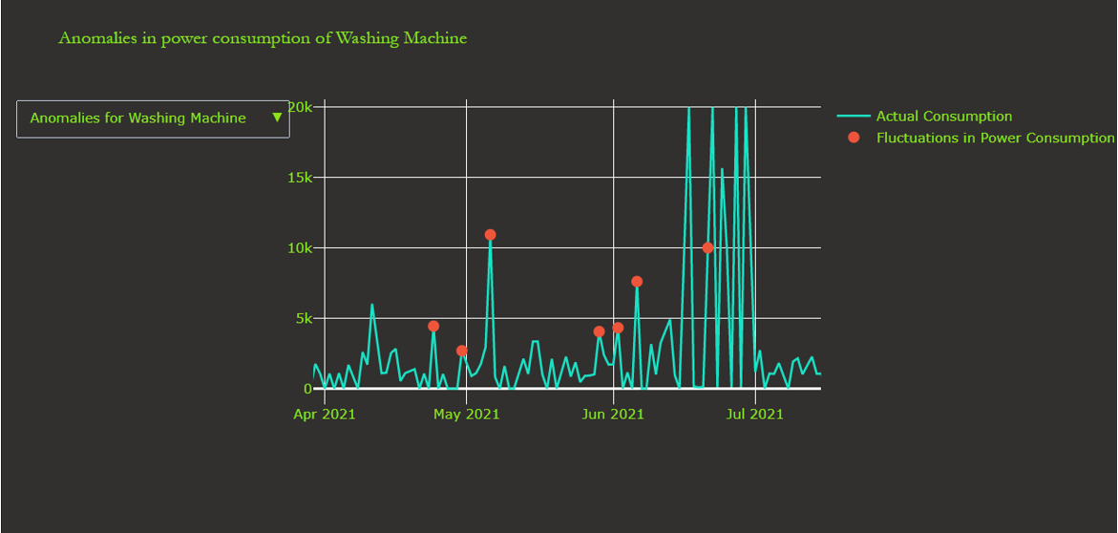
Quick Overview of Interface

Slide 7
Advantages
Cost saving on electricity bill
2) Power saving and efficiency
Reduces the electricity bill by 8-15% on a monthly basis based on how religiously the consumer utilizes the data
This will help in optimizing power consumption which will lead to less power outages/blackouts. This will also help in reducing the no. of plants

Slide 8
Advantages
3) Detection of faulty devices
4) Environmental Friendly
Helps in detecting faulty devices, thus prevents excess electricity consumption, MCB trips, etc.duces the electricity bill by 8-15% on a monthly basis based on how religiously the consumer utilizes the data
Helps to cut greenhouse emissions from electricity plants

Slide 9
Future improvements
1) Early Warning System
2) Mobile Alerts
When the user exceed the monthly electrical consumption limit/when it detects a electrical fault, a report will be sent to the user via Email
SMS notifications will be sent to users to alert them about excessive electrical consumption
3) Data Visualization
Users will be able to visualize their electrical consumption statistics after uploading their electrical bills

Slide 10
Thank you!

